Slide 1
The Inquiry Cycle
Visible Thinking Routines
& Language.

Slide 2
Aims
Enhance understanding of the role of the inquiry cycle in the design of units and planning of learning.
Become aware of the role Visible Thinking Routines can play in different stages of the IC.
Observe the language implications each VT Routine has for teaching and learning.
Visualize the relationship between techniques in ‘Approaches to learning’ and ‘Approaches to Teaching’ in the Inquiry Cycle.
Develop a personal approach for incorporating VT routines as a ATL strategy when planning inquiries.

Slide 3
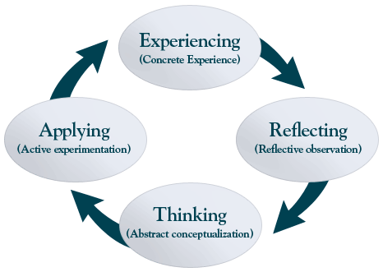
Essential understandings:
Key Concept: Connections
Related concept (Language Acq): Function, Purpose, Context
Global Context: Globalization and Sustainability- An exploration of the inter-connectedness of human-made systems and communities.
Statement of Inquiry: The process of inquiry involves a series of connections that contribute to the design of sustainable learning and considers function, purpose, and context.
Kolb and Fry’s Learning process
Notes:
Essential Agreements that need to be in place at beginning of workshop and reviewed at the beginning of Days 2 and 3. Use Kolb and Fry’s Learning Process as an engagement for what the participants will experience over the next three days.
Experiencing – Activities regarding inquiry in the MYP
Reflecting – Looking at these activities in the context of student learning
Thinking – How would these activities work in the participants own classroom setting
Applying – Starting to create and think about ways of acting upon learning from this professional development

Slide 4
Summative Assessment
Describe (and be ready to develop) the learning path that you’d design for your next unit of inquiry.
Evidence:
Clear understanding of the IC stages.
An effective collection of strategies (ATL: teaching and learning)
A broad and varied collection of resources (ideas)
A diverse collection of tools to employ
Relevant use of VT routines (+ language awareness)

Slide 5
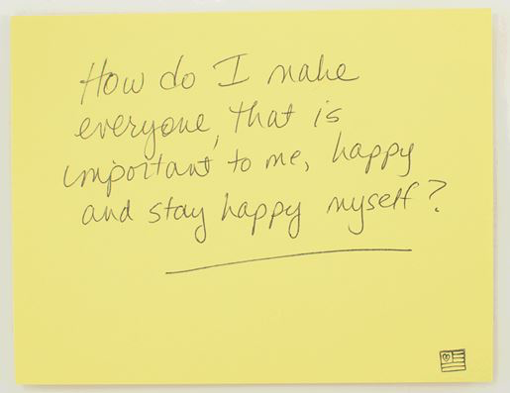
Questions worth asking
What questions would you like students to ask about ‘the gifts’ of your subject?
Notes:
This can be used in conjunction with Learner Profile in a later part of the day

Slide 6
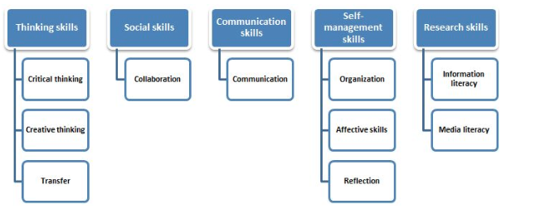
Approaches to Learning
*Also known as the 6 pedagogical principles.
Notes:
Up to workshop leader here – any method for group introductions!

Slide 7
Kolb and Fry
Find questions for inquiry
Gaining new perspectives
Attending to differences
Sharing what was learned
Planning new inquiries
Taking thoughtful action
Building from the known
(Kathy Short)
Notes:
Kolb and Fry (1975) argue that the learning cycle can begin at any one of the four points - and that it should really be approached as a continuous spiral. They further suggest that effective learning entails the possession of four different abilities and identification of a type of learner (as indicated on each pole of their model):
Converger: Strong in practical application of ideas, can focus on hypo-deductive reasoning on specific problems unemotional, has narrow interests
Diverger: Strong in imaginative ability, good at generating ideas and seeing things from different perspectives, interested in people, broad cultural interests
Assimilator: Strong ability to create theoretical models, excels in inductive reasoning, concerned with abstract concepts rather than people
Accommodator: Greatest strength is doing things, more of a risk taker, performs well when required to react to immediate circumstances, solves problems intuitively

Slide 8
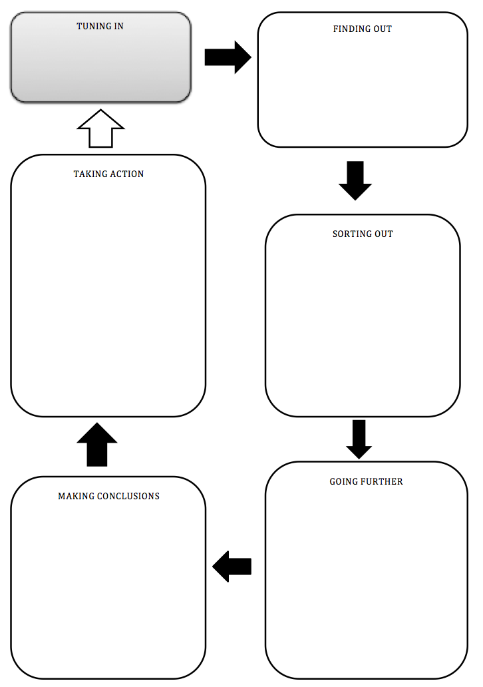
Kath Murdoch’s Inquiry cycle
Commonly used in PYP
A useful framework to map inquiry in MYP
A strategy to help students manage their learning in DP
Do now:
What happens in each stage?

Slide 9
Kath Murdoch’s Inquiry cycle
Commonly used in PYP
A useful framework to map inquiry in MYP
A strategy to help students manage their learning in DP
Do now:
What strategies are appropriate for each stage?

Slide 10
Visible thinking routines
http://tinyurl.com/vtroutx

Slide 11
Which routine is more appropriate for each stage?

Slide 12
Language in Visible Thinking Routines
Think-Pair-Share
Generate-Sort-Connect-Elaborate
Think-Puzzle-Explore
Connect-Extend-Challenge
See-Think-Wonder
Claim-Support-Question
Reporter’s notebook
Making it fair: Now Then Later
Compass Points
I used to think…. now I think

